Slide 1

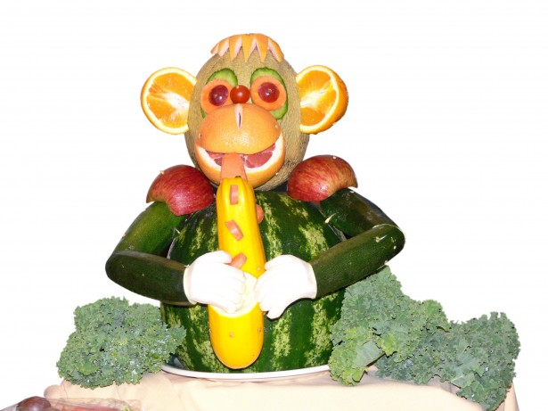




SHILBOTTLE PRIMARY SCHOOL
Menu 2024-2025
WEEK ONE
Alternative Option:- Cheesy Pasta/ ham or cheese sandwich. This must be ordered before 11am
 | Monday | Tuesday | Wednesday | Thursday | Friday
Main Course Choices
Potatoes Pasta/Rice
Vegetables
Salad bar
Sweets
Macaroni and cheese
Fish fingers
Roast chicken breast
Stuffing balls
Yorkshire Pudding
Gravy
Meatballs
in tomato and basil sauce
Margarita or pepperoni pizza
Garlic bread
Roast Potatoes
Pasta twists
Chips
Potato wedges
Peas
Sweetcorn & Carrots/ beans
Mixed Vegetables
Peas and carrots
beans/
Sweetcorn
Seasonal Salad & selection of fruit
Seasonal Salad & selection of fruit
Seasonal Salad & selection of fruit
Seasonal Salad & selection of fruit
Seasonal salad & selection of fruit
Cake
& Custard
Rice pudding with chocolate or strawberry sauce
Flap Jack
Chocolate krispie
Pudding of the day
Fresh Fruit and a selection of Breads are always available daily
Drinking Water is Available Daily on the Dining Room Tables
Menus are Subject to Change

Slide 2
FIRST & PRIMARY SCHOOL
MENU 2024-2025
WEEK TWO
Alternative Option is Cheesy Pasta/ ham or cheese sandwich. This must be ordered before 11am
 | Monday | Tuesday | Wednesday | Thursday | Friday
Main Course Choices
Potatoes Pasta / Rice |  |  |  |  | French fries
Vegetables
Salad Bar
Starters or Sweets
Chinese chicken curry & prawn crackers
Sausage Roll
Roast ham
Stuffing Balls
Yorkshire Puddings/
Gravy
Cheese/ ham and cheese wraps
Beef burgers and cheese
Pasta twists
Rice
Potato Smiles
Roast Potatoes
Peas
Peas & Carrots/ beans
Mixed Vegetables
Sweetcorn & carrots
Sweetcorn/Beans
Seasonal Salad & selection of fruit
Seasonal Salad & fruit selection
Seasonal salad & fruit selection
Seasonal salad & fruit selection
Seasonal salad & fruit selection
Warm chocolate brownie and cream
Marshmallow krispie cakes
Pudding of the day
Cake & Custard
Chocolate Chip Muffin
Fresh Fruit and a selection of Breads are always available daily
Drinking Water is Available Daily on the Dining Room Tables
Menus are Subject to Change

Slide 3
FIRST & PRIMARY SCHOOL
MENU 2024-2025
WEEK THREE
Alternative Option: Cheesy Pasta/ ham or cheese sandwich. This must be ordered before 11am
 | Monday | Tuesday | Wednesday | Thursday | Friday
Main Course Choices
Potatoes Pasta / Rice
Vegetables
Salad Bar
Starters or Sweets | Cake & custard
Chicken korma & naan bread
Pork sausages
Roast turkey
Stuffing balls
Yorkshire pudding
gravy
Tuna or cheese melt
Chicken goujons
Rice
Hash browns
Roast potatoes
Pasta twists
Chips
Peas
Peas & Carrots/ beans
Mixed vegetables
Sweetcorn & carrots
Sweetcorn & carrots
Seasonal Salad & fruit selection
Seasonal Salad & fruit selection
Seasonal Salad & fruit selection
Seasonal Salad & fruit selection
Seasonal Salad & fruit selection
Pancakes with chocolate or strawberry sauce
Warm chocolate brownie with cream
Chocolate Krispie
Pudding
of the day
Fresh Fruit and a selection Breads are always available daily
Drinking Water is Available Daily on the Dining Room Tables
Menus are Subject to Change

